Slide 1
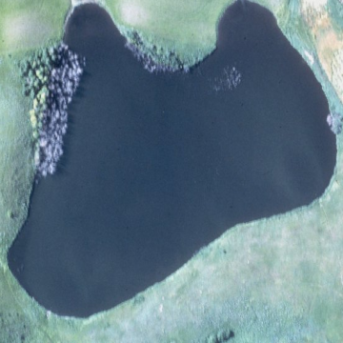
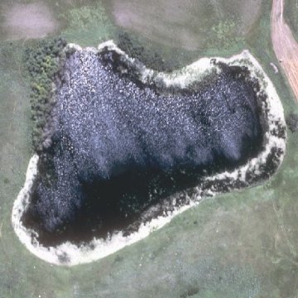
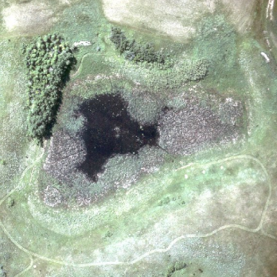
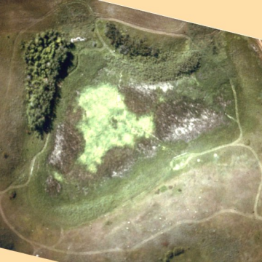
The Effect of Evapo-concentration on the Water Chemistry of Prairie Wetlands
A PHREEQC Modeling Exercise
by
Vanessa O’Connor and David Mushet

Slide 2
1895
1905
1915
1925
1935
1945
1955
1965
1975
1985
1995
2005
Data Courtesy of National Climatic Data Center
http://lwf.ncdc.noaa.gov/oa/climate/onlineprod/drought/main.html

Slide 3
WETLAND P1
WATER DEPTH (M)
1979
1982
1999
2001
1983
1984
1994
1995
1985
1996
1998
1986
2000
1987
1991
1992
1988
1990
1993
1997
1980
1989
1981
Data Courtesy of Dr. Don Rosenberry, U.S. Geological Survey
Water Resources Division, Denver, Colorado

Slide 4
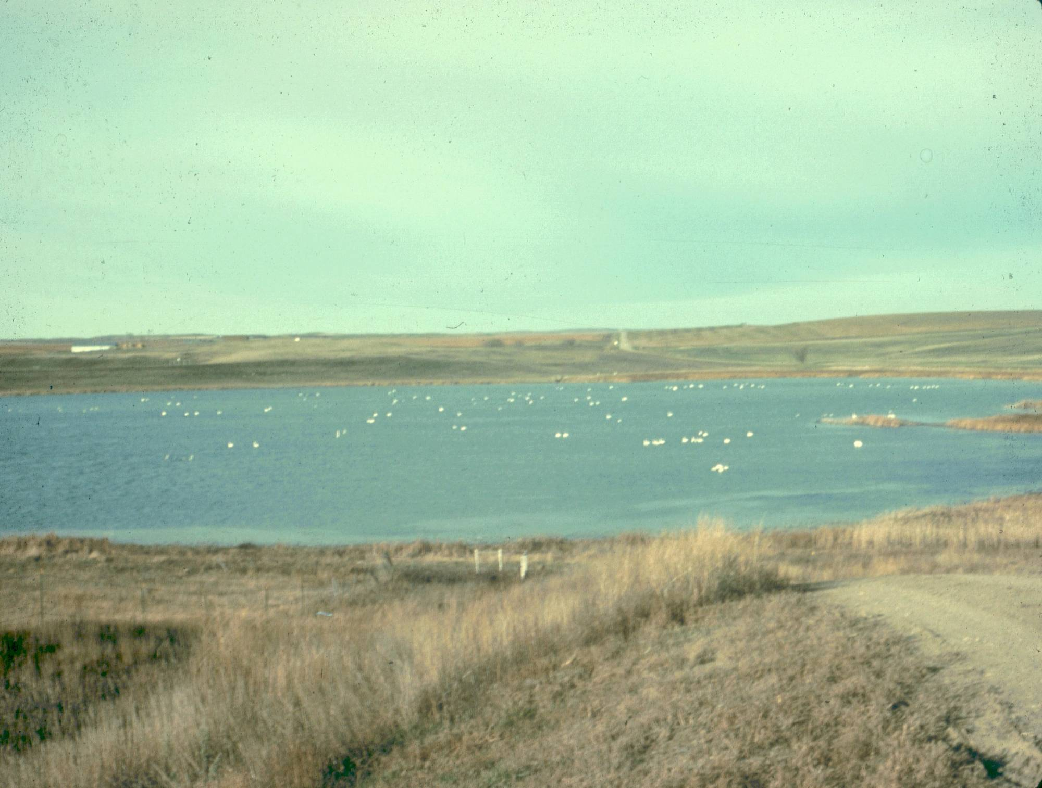
Photo Courtesy of U.S. Geological Survey,
Northern Prairie Wildlife Research Center, Jamestown, North Dakota

Slide 5
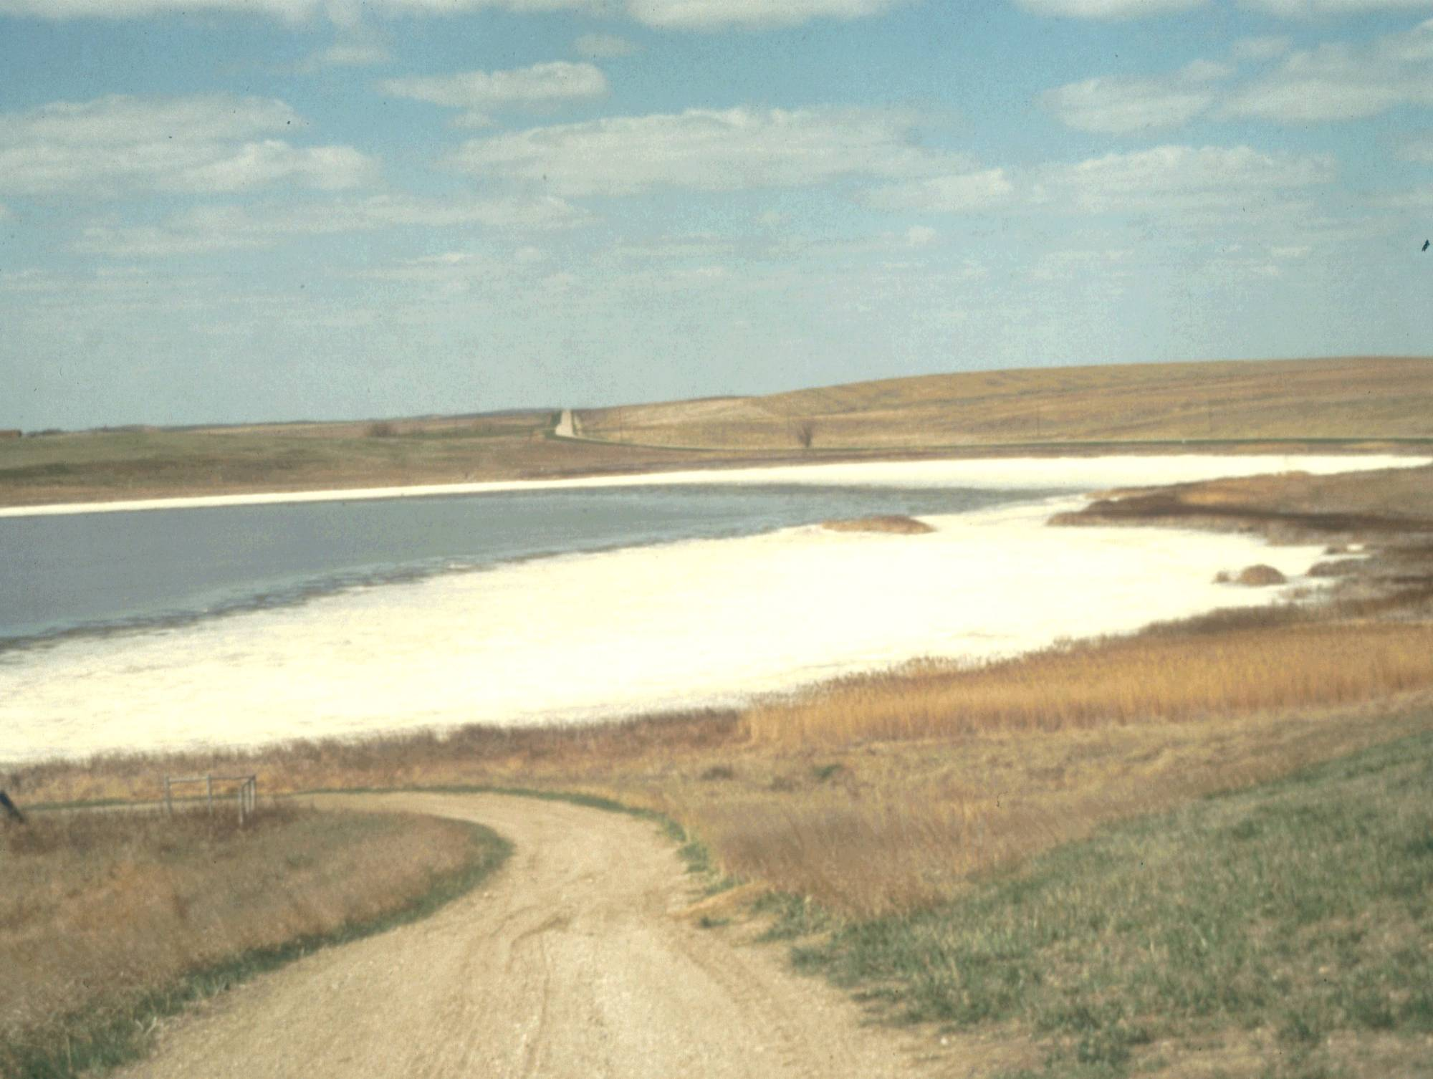
Photo Courtesy of U.S. Geological Survey,
Northern Prairie Wildlife Research Center, Jamestown, North Dakota

Slide 6
WETLAND P1
WATER DEPTH (M)
1979
1982
1999
2001
1983
1984
1994
1995
1985
1996
1998
1986
2000
1987
1991
1992
1988
1990
1993
1997
1980
1989
1981
Data Courtesy of Dr. Don Rosenberry, U.S. Geological Survey
Water Resources Division, Denver, Colorado

Slide 7
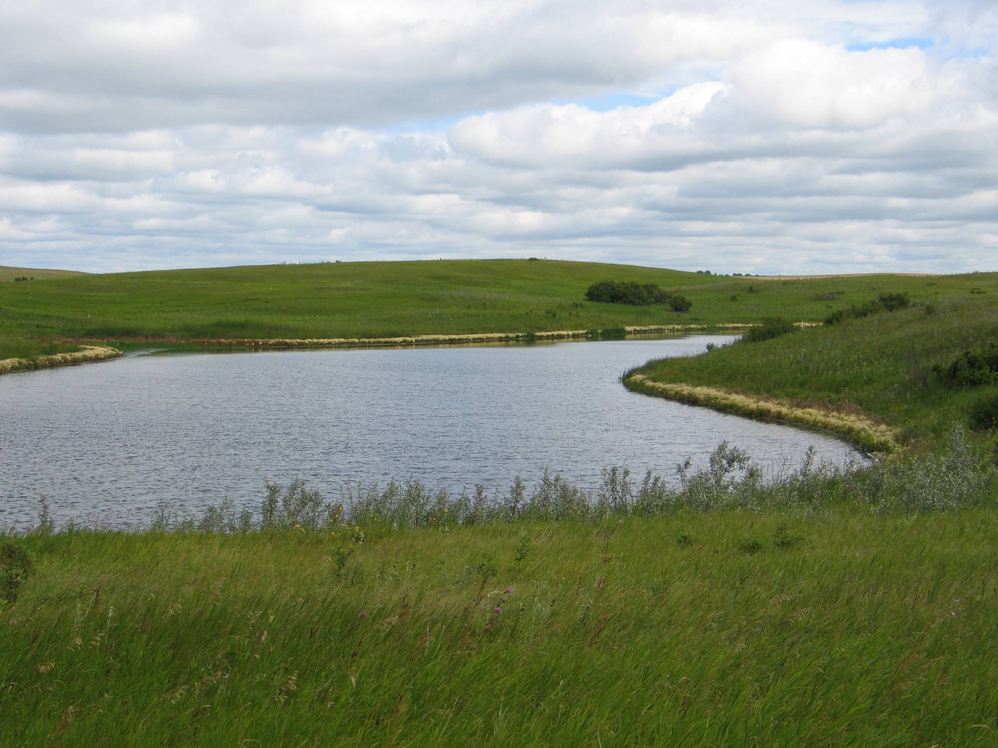
SPRING
Photo by D. M. Mushet

Slide 8
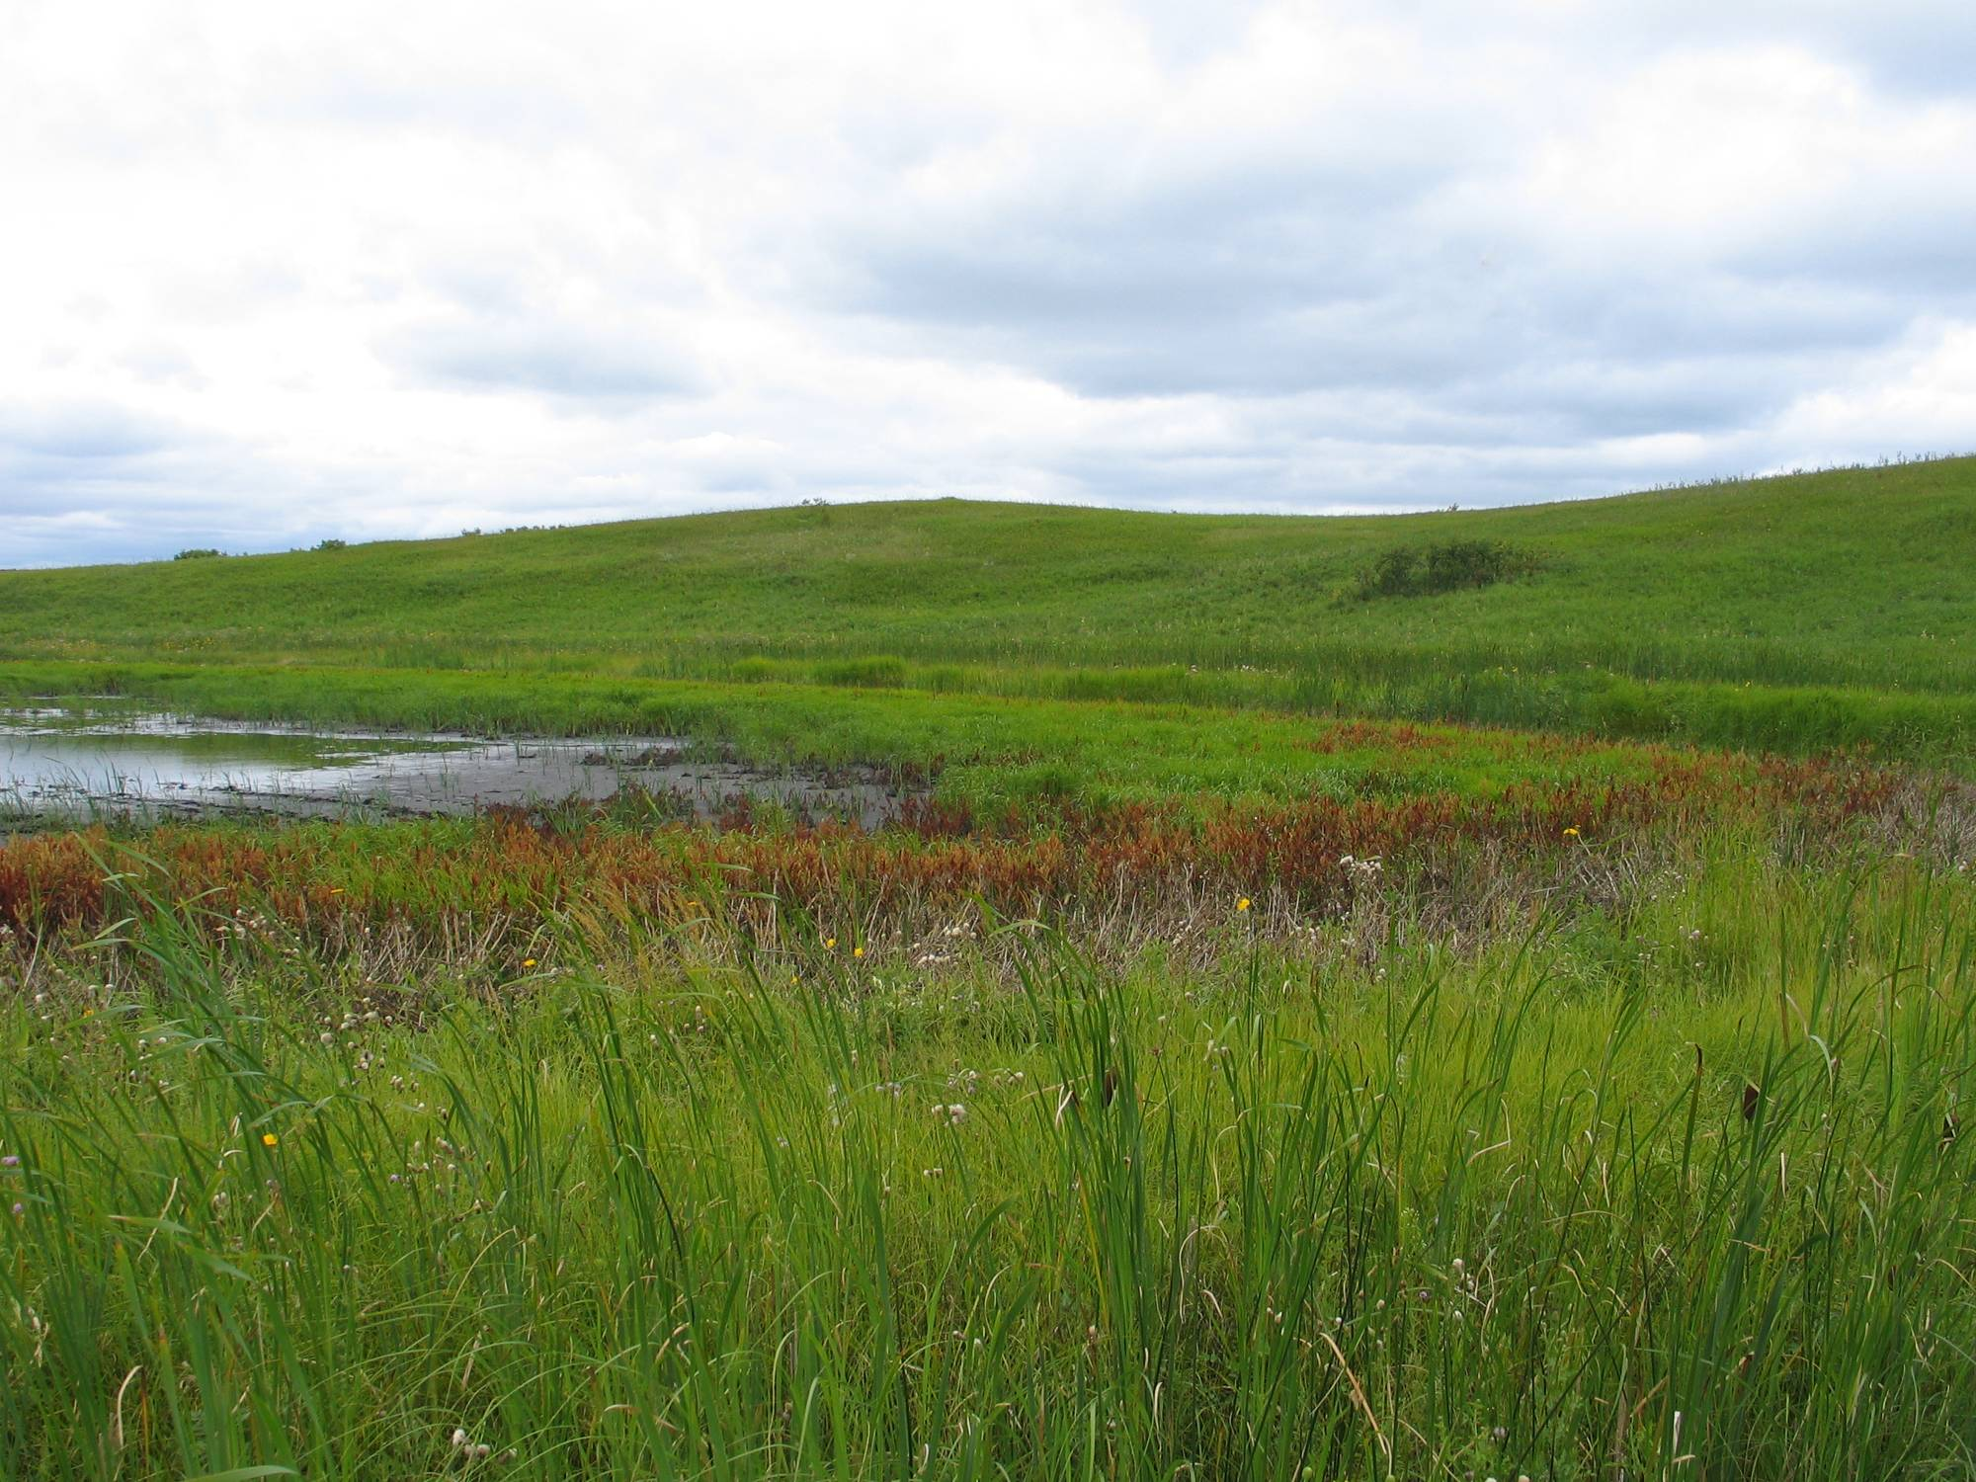
SUMMER
Photo by D. M. Mushet

Slide 9
Wetland Hydrological Functions
T8
P1
P11
Recharge
Flow Through
Discharge

Slide 10
Cottonwood Lake Study Area Wetlands
Beginning Concentrations (ppm)
Constituent | T8 | P1 | P11
 | May 14, 2001 | May 14, 2001 | May 14, 2001
EC μS/cm | 150 | 1640 | 2150
pH | 7.44 | 8.70 | 8.77
Alkalinity | 66.3 | 371.6 | 449.4
Ca | 10.6 | 88.4 | 56.8
Mg | 6.1 | 148.3 | 111.8
Na | 1.4 | 80.3 | 264.5
K | 23.41 | 23.7 | 40.15
SO₄²⁻ | 21.8 | 710.2 | 756.6
Cl⁻ | 4.84 | 14.28 | 63.79
N | 3.3 | 3.4 | 3.2
P | 0.54 | 0.15 | 0.25
Data Courtesy of Dr. Jim LaBaugh, U.S. Geological Survey
Water Resources Division, Reston, Virginia

Slide 11
Cl⁻
Na⁺ + K⁺
Ca²⁺
T8
P11
P1
P11
T8
P1
SO₄²⁻
CO₃²⁻ + HCO₃⁻
Mg²⁺
Modified from Faure, G. 1998. Principles and Applications of Geochemistry,
Second Edition. Figure 20.6. Prentice Hall, Upper Saddle River, New Jersey.

Slide 12
PHREEQC Program (part 1)
TITLE P1 Evapoconcentration (-95% H2O)
SOLUTION 1 May 14, 2001, Starting Concentrations
temp 21.2
pH 8.7
pe 4
redox pe
units mg/l
density 1
Ca 88.4
Mg 148.3
Na 80.3
K 23.7
Cl 14.28
P 0.15
N 3.4
Alkalinity 371.66
S(6) 710.2
-water 1 # kg
REACTION 1
H2O -1
52.73 moles
EQUILIBRIUM_PHASES 1
CO2(g) -3.5 10
SAVE solution 2
END
For 25% evaporation,
13.88 moles of H₂O
would be removed.
27.75 moles for 50%
41.63 moles for 75%
Etc.
One Liter of H₂O is
Approximately
55.5 moles
This Code Removes
95% (52.73 moles)
of the H₂O

Slide 13
PHREEQC Program (part 2)
TITLE Example 4b.--Factor of 20 more solution
MIX 1
2 20
SAVE solution 3
END
For 25% evaporation
(i.e., 0.75kg solution)
solution 2 would be increased 1.3
0.50kg (50% evaporation) by 2
0.25kg (75% evaporation) by 4
This code increases
solution 2 by a factor of 20
to bring it back to the
1 kg standard
Solution 2 is now
0.05 kg (i.e., 5% of the
1kg Starting Solution)

Slide 14
EXAMPLE
Constituent | Solution 1 | Solution 2 | Solution 3
Mass of Water, kg | 1.000 | 0.050 | 1.000
Ca, mol | 2.21E-03 | 2.21E-03 | 4.42E-02
Ca, mol/kg water | 2.21E-03 | 4.42E-02 | 4.42E-02

Slide 15
Cottonwood Lake Study Area Wetland T8
Constituent | Solution 1 | Solution 2 | Solution 3 | Solution 4 | Solution 5
 | May 14, 2001 | 25% Evaporation | 50% Evaporation | 75% Evaporation | 95% Evaporation
Mass of water, kg | 1.00 | 0.75 | 0.50 | 0.25 | 0.05
pH | 7.44 | 7.43 | 7.43 | 7.41 | 7.36
Ca | 2.65E-04 | 3.53E-04 | 5.29E-04 | 1.06E-03 | 5.29E-03
Mg | 2.51E-04 | 3.35E-04 | 5.02E-04 | 1.00E-03 | 5.02E-03
Na | 6.09E-05 | 8.12E-05 | 1.22E-04 | 2.44E-04 | 1.22E-03
K | 5.99E-04 | 7.98E-04 | 1.20E-03 | 2.40E-03 | 1.20E-02
HCO₃⁻ | 1.30E-03 | 1.73E-03 | 2.59E-03 | 5.13E-03 | 2.48E-02
SO₄²⁻ | 2.12E-04 | 2.78E-04 | 4.06E-04 | 7.65E-04 | 3.18E-03
Cl⁻ | 1.37E-04 | 1.82E-04 | 2.73E-04 | 5.46E-04 | 2.73E-03
N | 2.36E-04 | 3.14E-04 | 4.71E-04 | 9.43E-04 | 4.71E-03
P | 1.74E-05 | 2.33E-05 | 3.49E-05 | 6.98E-05 | 3.49E-04

Slide 16
Wetland T8 Solubility Indexes (SI)
Constituent | Solution 1 | Solution 2 | Solution 3 | Solution 4 | Solution 5
 | May 14, 2001 | 25% Evaporation | 50% Evaporation | 75% Evaporation | 95% Evaporation
Calcite CaCO₃ | -1.03 | -0.81 | -0.50 | 0.00 | 1.07
Aragonite CaCO₃ | -1.18 | -0.96 | -0.65 | -0.14 | 0.92
Dolomite CaMg(CO₃)₂ | -1.98 | -1.54 | -0.92 | 0.09 | 2.22
Gypsum CaSO₄ : 2H₂O | -2.88 | -2.66 | -2.37 | -1.90 | -0.94
Anhydrite CaSO₄ | -3.10 | -2.89 | -2.60 | -2.13 | -1.17
Halite NaCl | -9.71 | -9.46 | -9.12 | -8.54 | -7.23

Slide 17
Cottonwood Lake Study Area Wetland P1
Constituent | Solution 1 | Solution 2 | Solution 3 | Solution 4 | Solution 5
 | May 14, 2001 | 25% Evaporation | 50% Evaporation | 75% Evaporation | 95% Evaporation
Mass of water, kg | 1.00 | 0.75 | 0.50 | 0.25 | 0.05
pH | 8.70 | 8.65 | 8.58 | 8.47 | 8.22
Ca | 2.20E-03 | 2.95E-03 | 4.42E-03 | 8.84E-03 | 4.42E-02
Mg | 6.11E-03 | 8.15E-03 | 1.22E-03 | 2.44E-02 | 1.22E-01
Na | 3.50E-03 | 4.66E-03 | 7.00E-03 | 1.40E-02 | 6.99E-02
K | 6.07E-04 | 8.09E-04 | 1.21E-03 | 2.43E-03 | 1.21E-02
HCO₃⁻ | 6.00E-03 | 7.94E-03 | 1.17E-02 | 2.27E-02 | 9.94E-02
SO₄²⁻ | 5.42E-03 | 6.98-03 | 9.96E-03 | 1.83E-02 | 1.48E-01
Cl⁻ | 4.03E-04 | 5.38E-04 | 8.07E-04 | 1.61E-03 | 7.61E-02
N | 2.43E-04 | 3.24E-04 | 4.86E-04 | 9.72E-04 | 4.86E-03
P | 4.85E-06 | 6.47E-06 | 9.70E-06 | 1.94E-05 | 9.70E-05

Slide 18
Wetland P1 Solubility Indexes (SI)
Constituent | Solution 1 | Solution 2 | Solution 3 | Solution 4 | Solution 5
 | May 14, 2001 | 25% Evaporation | 50% Evaporation | 75% Evaporation | 95% Evaporation
Calcite CaCO₃ | 1.43 | 1.58 | 1.78 | 2.11 | 2.87
Aragonite CaCO₃ | 1.29 | 1.43 | 1.63 | 1.97 | 2.73
Dolomite CaMg(CO₃)₂ | 3.40 | 3.69 | 4.09 | 4.76 | 6.30
Gypsum CaSO₄ : 2H₂O | -1.03 | -0.87 | -0.64 | -0.28 | 0.52
Anhydrite CaSO₄ | -1.26 | -1.10 | -0.88 | -0.51 | 0.30
Halite NaCl | -7.57 | -7.34 | -7.01 | -6.46 | -5.19

Slide 19
Cottonwood Lake Study Area Wetland P11
Constituent | Solution 1 | Solution 2 | Solution 3 | Solution 4 | Solution 5
 | May 14, 2001 | 25% Evaporation | 50% Evaporation | 75% Evaporation | 95% Evaporation
Mass of water, kg | 1.00 | 0.75 | 0.50 | 0.25 | 0.05
pH | 8.77 | 8.72 | 8.66 | 8.54 | 8.28
Ca | 1.42E-03 | 1.89E-03 | 2.84E-03 | 5.68E-03 | 2.84E-02
Mg | 4.61E-03 | 6.14E-03 | 9.21E-03 | 1.84E-02 | 9.21E-02
Na | 1.15E-02 | 1.54E-02 | 2.31E-02 | 4.61E-02 | 2.30E-01
K | 1.03E-03 | 1.37E-03 | 2.06E-03 | 4.11E-03 | 2.06E-02
HCO₃⁻ | 7.24E-03 | 9.59E-03 | 1.42E-02 | 2.77E-02 | 1.24E-01
SO₄²⁻ | 6.16E-03 | 7.99E-03 | 1.15E-02 | 2.15E-02 | 8.93E-02
Cl⁻ | 1.80E-03 | 2.40E-03 | 3.60E-03 | 7.21E-03 | 3.60E-02
N | 2.29E-04 | 3.05E-04 | 4.58E-04 | 9.16E-04 | 4.58E-03
P | 8.09E-06 | 1.08E-05 | 1.62E-05 | 3.23E-05 | 1.62E-04

Slide 20
Wetland P11 Solubility Indexes (SI)
Constituent | Solution 1 | Solution 2 | Solution 3 | Solution 4 | Solution 5
 | May 14, 2001 | 25% Evaporation | 50% Evaporation | 75% Evaporation | 95% Evaporation
Calcite CaCO₃ | 1.40 | 1.55 | 1.75 | 2.08 | 2.82
Aragonite CaCO₃ | 1.26 | 1.40 | 1.60 | 1.93 | 2.68
Dolomite CaMg(CO₃)₂ | 3.45 | 3.74 | 4.14 | 4.81 | 6.31
Gypsum CaSO₄ : 2H₂O | -1.22 | -1.06 | -0.84 | -0.49 | 0.30
Anhydrite CaSO₄ | -1.44 | -1.28 | -1.06 | -0.70 | 0.09
Halite NaCl | -6.42 | -6.19 | -5.86 | -5.32 | -4.06

Slide 21
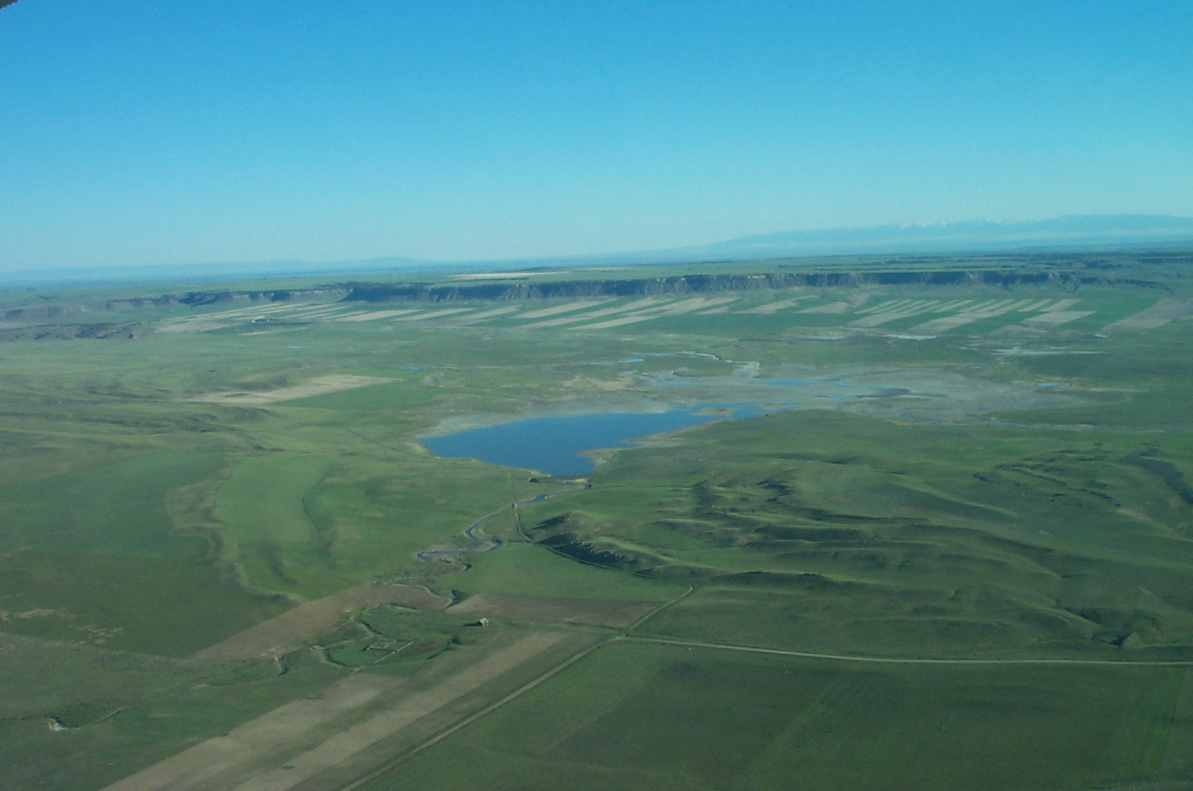
Hailstone National Wildlife Refuge Soon After Dam Construction
Photo Courtesy of U.S. Fish and Wildlife Service,
Hailstone NWR, Lewistown, Montana

Slide 22
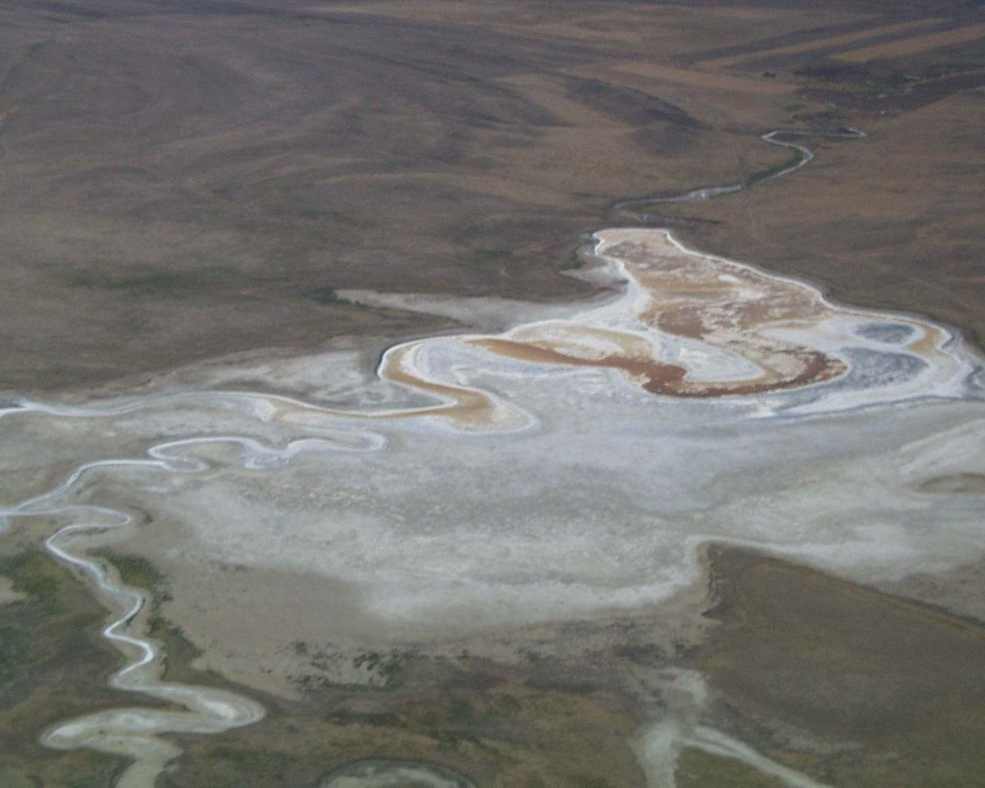
Hailstone National Wildlife Refuge Soon As It Appears Today
Photo Courtesy of U.S. Fish and Wildlife Service,
Hailstone NWR, Lewistown, Montana

Slide 23
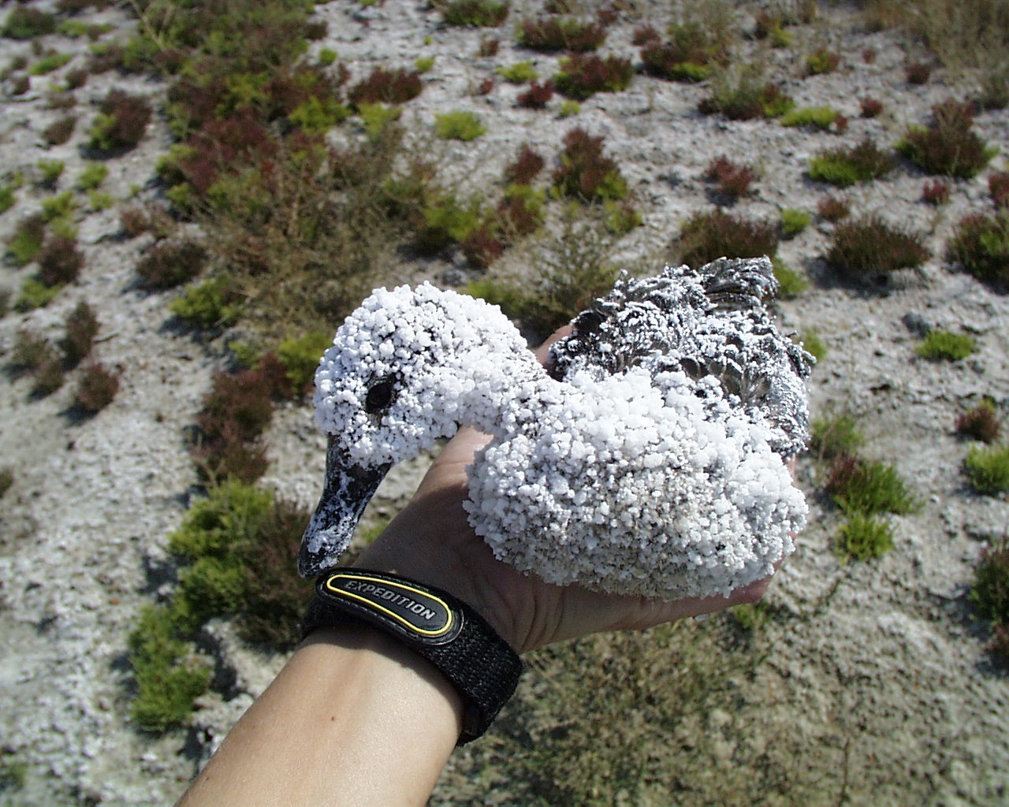
Photo Courtesy of U.S. Fish and Wildlife Service,
Hailstone NWR, Lewistown, Montana

